Slide 1
Project #1
Musa Harshuk & yarden fabian

Slide 2
Work plan and steps:
Phase 1 – Analysis
A - Table analysis & question asking
B – technical analysis (SQL,Excel,tableau)
Phase 2 – visualization
A – choosing the most useful data
B- building graphs and dashboards
Phase 3 – turning data into words
- Conclusions and finalizing the project

Slide 3
Phase 1- A
Our research questions:
1 - What is the company's profit in each of the stores? Is there a big difference in profits between stores?
2 - What is the volume of shopping and customers in each of the stores?
3 - What products would you recommend for the company to continue selling and marketing? Which products would you recommend to change marketing / remove from company sales?
4- What are the most profitable categories?
5 - Which brands are worthwhile to own?
6 - which state has the most customers?
7 - In which months we have the most volume?
8 - which staff has the most sales?

Slide 4
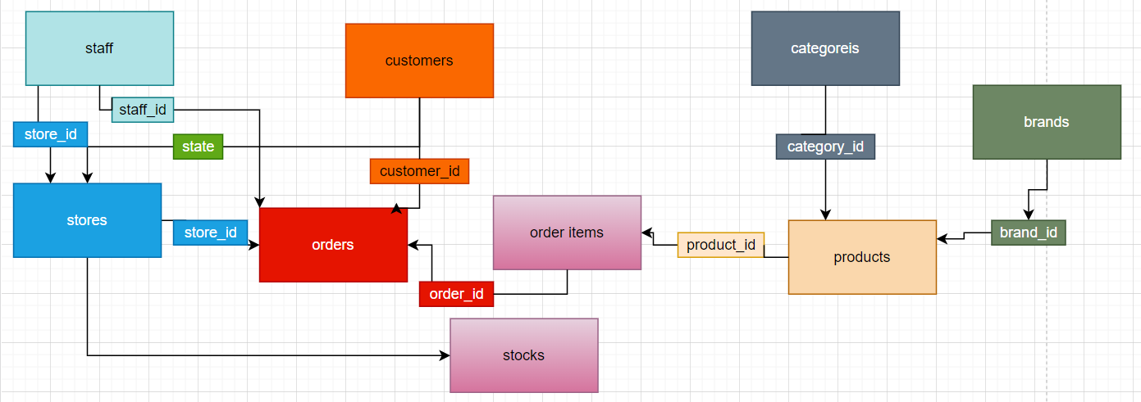
Phase 1 – tables analysis

Slide 5
Phase – 1 – tables analysis
Phase 1:
Table analysis :products
purpose: to show us data about the products of our company
unique id :product_id
data types: nvarchar(255)
main columns: product_id,brand_id,categpry_id
size: 6columns * 321 rows
connections:
brands table via brand_id
categories table via category_id
order_items via product_id
stocks via product_id
Phase 1:
Table analysis : brands
purpose: to show us which brands are our stores and products
unique id : brand_id
data types: nvarchar(255)
main columns: brand_id,brand_name
size:2 columns * 9rows
connections: products table via brand_id
Phase 1:
Table analysis : customers
purpose: to show who us data about our customers
unique id :customer_id
data types: nvarchar(255)
main columns: customer_id,state,
size: 9columns * 1445 rows
connections: table orders via customer id
Phase 1:
Table analysis : categories
purpose: to show what categories we have in our company
unique id : category_id
data types: nvarchar(255)
main columns: category_id,category_name
size: 2 columns *7 rows
connections: products table via category_id
Phase 1:
Table analysis : stores
purpose: to show us data about the store that we have
unique id: store_id
data types
main columns: store_d,state
size:
connections:
via store_id -> stocks,staff,orders,
customers via state

Slide 6
Phase – 1 – tables analysis
Phase 1:
Table analysis : orders
purpose: to show us the data about all the orders of our customers
unique id: order_id
data types: nvarchar(255)
main columns: order_id,customer_id,store_id,staff_id
size: 8 columns* 1615 rows
connections:
table order_items via order_id
table customers via customer_id
stores table via store_id
staff table via staff_id
Phase 1:
Table analysis : order_items
purpose: to show us data about the items inside the orders
unique id : item_id
data types: float, nvarchar(255)
main columns: order_id,item_id,product_id
size: 6 columns * 4722 rows
connections:
table orders via order_id
table products via product id
Phase 1:
Table analysis : staff
purpose: to show us data about the staff of the stores
unique id:staff_id ,manger_id
data types: nvarchar(255)
main columns:staff_id,store_id,manger_id
size: 8 columns * 10 rows
connections:
stores table via store_id
orders via staff_id
Phase 1:
Table analysis : stocks
purpose: to show us how many of each product we have in our stocks
unique id: null
data types: nvarchar(255)
main columns: store_id, product_id
size: 3 columns * 939 rows
connections:
products table via product_id
store via store_id

Slide 7
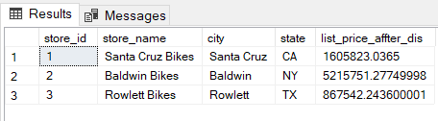
Phase 1 – B : technical analysis
1- What is the company's profit in each of the stores? Is there a big difference in profits between stores?
We have checked every stores ordered items and calculated(price*quantity)-(price*quantity*discount)Which gave us the amount of money each store got,There were significant differences between the stores
select q1.store_id,s.store_name,s.city,s.state,list_price_affter_dis
from
(select store_id,
sum(i.list_price*cast(quantity as float)-(i.list_price*discount*cast(quantity as float))) list_price_affter_dis
from orders o
join order_items i
on o.order_id = i.order_id
group by store_id)q1
join stores s
on q1.store_id = s.store_id

Slide 8
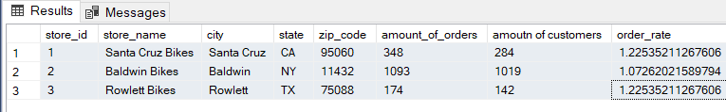
Phase 1 – B:
2 - What is the volume of shopping and customers in each of the stores?
By volume we checked the amount of orders ,amount of customers and the order rate for each customer in each store
select q1.store_id,store_name,city,state,zip_code,amount_of_orders,[amoutn of customers],order_rate from
(select store_id, count(distinct order_id) amount_of_orders,count(distinct customer_id) 'amount of customers',
cast(count(distinct order_id) as float)/count(distinct customer_id) order_rate
from orders o
group by store_id) q1
join stores s
on q1.store_id= s.store_id

Slide 9
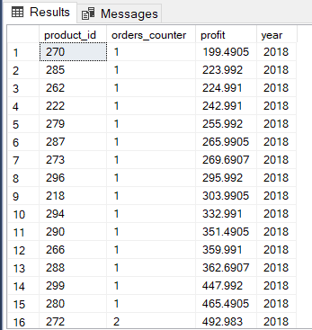
Phase 1 – B: 3 part 1
3- What products would you recommend for the company to continue selling and marketing? Which products would you recommend to change marketing / remove from company sales?
In this query I selected the amount of orders, sum of profit and model year for each of the products. I added a filter in order to show only the products that their yearly profit is less than 1,000 and their order amount is less than 3.
The results are the least profitable and least selling products ordered by their profit
select b.product_id,COUNT(distinct a.order_id) orders_counter,
SUM((cast(b.list_price as float)*quantity)*(1-discount)) profit,
year(model_year) year
from [dbo].[orders]a
join [dbo].[order_items]b on b.order_id=a.order_id
join [dbo].[products]c on b.product_id=c.product_id
group by b.product_id,c.model_year
having SUM((cast(b.list_price as float)*quantity)*(1-discount))/(2019-model_year)<=1000
and COUNT(distinct a.order_id)<3
order by profit
.

Slide 10
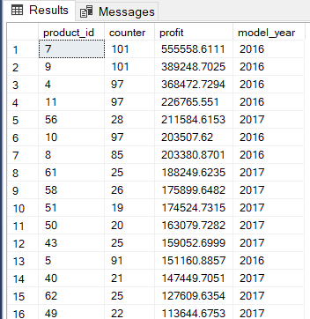
Phase 1 – B-3 part 2
In this query I selected the amount of orders, sum of profit and model year for each of the products. I added a filter in order to show only the products that their yearly average profit is higher than 10,000 or their yearly average order amount is higher than 15.
The results are the most profitable and most selling products ordered by their profit in descending order.
select b.product_id,COUNT(distinct a.order_id) counter,
SUM((cast(b.list_price as float)*quantity)*(1-discount)) profit,model_year
from [dbo].[orders]a
join [dbo].[order_items]b on b.order_id=a.order_id
join [dbo].[products]c on b.product_id=c.product_id
group by b.product_id,c.model_year
having SUM((cast(b.list_price as float)*quantity)*(1-discount))/(2019-model_year)>10000
or COUNT(a.order_id)/(2019-model_year)>=15
order by profit desc

Slide 11
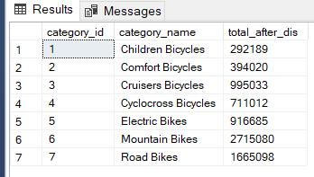
Phase 1 – B:
4 - What are the most profitable categories?
Cucullated the amount of items that were sold on each category
select q1.store_id,s.store_name,s.city,s.state,list_price_affter_dis
from
(select store_id,
sum(i.list_price*cast(quantity as float)-(i.list_price*discount*cast(quantity as float)))
list_price_affter_dis
from orders o
join order_items ion o.order_id = i.order_id group by store_id)q1
join stores s
on q1.store_id = s.store_id

Slide 12
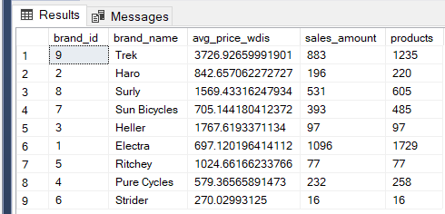
Phase 1 – B:
5 - Which brands are worthwhile to own?
We basically checked the volume of the brands to see which one bring more money and traffic
select b.brand_id ,b.brand_name,
avg(cast(i.list_price as float) * i.quantity-(cast(i.list_price as float) * i.quantity*discount)) avg_price_wdis
,count(distinct i.order_id) sales_amount
,count(i.item_id) products
from order_items i
join
products p
on i.product_id =p.product_id
join brands b on b.brand_id =p.brand_id
group by b.brand_id ,b.brand_name

Slide 13
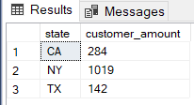
Phase 1 – B:
.
6-which state has the most customers?
In this query I selected the amount of customer for each state.
The results show which state has the largest and
select state,count(distinct customer_id) customer_amount
from [dbo].[customers]
group by state
smallest amount of customers

Slide 14
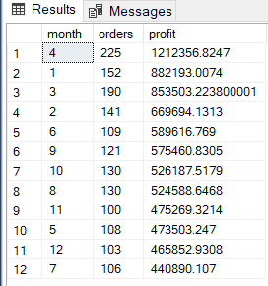
Phase 1 – B:
7-In which months we have the most volume?
In this query I selected the amount of orders, sum of profit for each month.
The results show the months total profit and order amount sorted by the total profit in descending order
select month(order_date) as month,count(distinct a.order_id) orders ,SUM((cast(b.list_price as float)*quantity)*(1-discount)) profit
from [dbo].[orders]a
join [dbo].[order_items]b
on b.order_id=a.order_id
group by month(order_date) order by profit desc
.

Slide 15
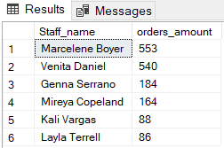
Phase 1 – B:
8- which staff has the most sales?
In this query I selected the amount of orders and full staff name for each of the staff members.
The results show which staff member has sold the largest amount of orders.
select a.first_name+' '+a.last_name as Staff_name,count(distinct order_id) orders_amount
from [dbo].[staffs]a
join [dbo].[orders]b on a.staff_id=b.staff_id
group by a.staff_id,a.first_name,a.last_name
order by orders_amount desc

Slide 16
Phase – 3 :
Based of phase 1 & 2 we got conclusion about the analysis we have done about the company “fast and furious”:
Q1) What is the company's profit in each of the stores? Is there a big difference in profits between stores?
Q2 - What is the volume of shopping and customers in each of the stores?
Conclusion: we have a big difference in our company between our stores ,majority of our sales are from one major store “baldwin bikes”
By majority I mean 67% of our income is from them , most of our volume is also at that store they have the biggest amount of customers
The biggest amount of orders, we shall consider spreading our sources of income

Slide 17
Phase – 3:
Q3 – What products would you recommend for the company to continue selling and marketing? Which products would you recommend to change marketing / remove from company sales?
Conclusion: we have found the products that are the most and the least profitable and popular we have found our that we have a group of products that should be removed from our usage and trying to sell it, these products have been in the market for more that 1 year and haven’t sold above 10 products with that they haven’t got above 1000$ income.

Slide 18
Phase – 3:
4- What are the most profitable categories?
Conclusion:
We have check every category and how much do they profit the company and we have found out that
We have better preforming and less preforming categories and we shall consider removing the least preforming categories and investing more in the better categories ,
For example we need to invest in road bike category more and less in comfort category
Because it’s a more selling category

Slide 19
Phase – 3:
5 - Which brands are worthwhile to own?
Conclusion:
We have checked each brand its total income for the company and the amount of orders that the bring , we have gotten to an conclusion n that we need to stop working with certain brand that are underperforming and very unprofitable in comparison to the other brands .
Brand such as : ratchet , strider, heller have less that 100 orders since 2016 and not have been profitable enough , all the other brand are preforming well and we need to keep working with them , especially “trek” with the most income and “Electra with the most orders.

Slide 20
Phase – 3:
6 - which state has the most customers?
Conclusion:
After our analysis about the states, we have found out in which state we have the most customers and that state is NY we shall consider developing in that state more.

Slide 21
Phase – 3:
7 - In which months we have the most volume?
Conclusion:
We can see that during the months of spring we have the best sales
Maybe we shall focus on these month more on marketing to improve the sales even more

Slide 22
Phase – 3:
8 - which staff has the most sales?
Conclusion: we searched for the best manger here and we found our that our staff has 2 outstanding manger ‘marcel’ marcel and ‘Venita’
We need to analyze their characteristics and hire more mangers like them

Slide 23
Phase – 3:
Summary –
We have analyzed the company In various aspects and we have got conclusions for every aspect , we recommend that these conclusions shall take in consideration in the future decision making of the company, these conclusion come for both Phase 1 & Phase 2

